Slide 1
Exposys Project
Different Regression Algorithms on 50 companies dataset
- Liyakhat yousuf mogal

Slide 2
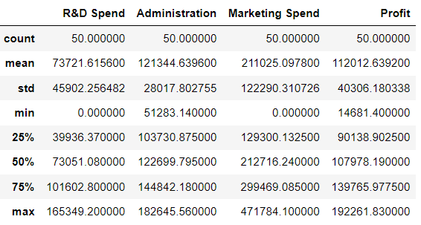
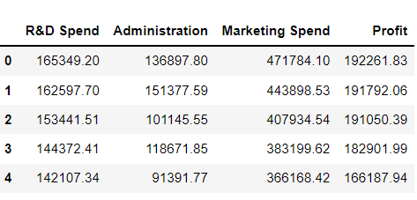
About the dataset:
Given dataset is about the 50 startups, each of these companies have recorded their R&D spent, Administration Cost, Marketing and their overall profits earned.
Columns in the Dataset
R&D Spend - Cost spent on Research and Development
Administration Cost - Cost spent on support of business, indirectly related to specific product or service
Marketing Spend - Cost spent on the marketing of products or services provided by the companies
Profit - Overall profit earned by the companies

Slide 3
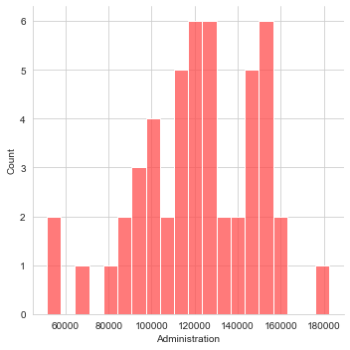
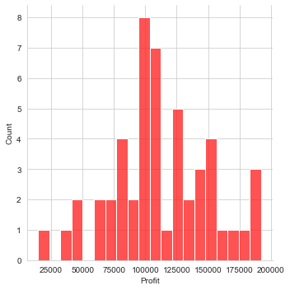
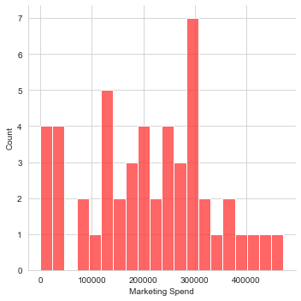
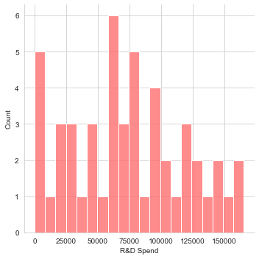
Exploratory Data Analysis:
Distribution plot for R&D Spend, Administration, Marketing Spend, Profit

Slide 4
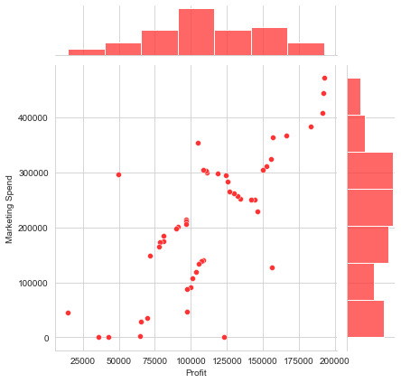
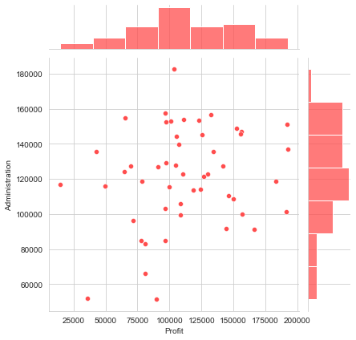
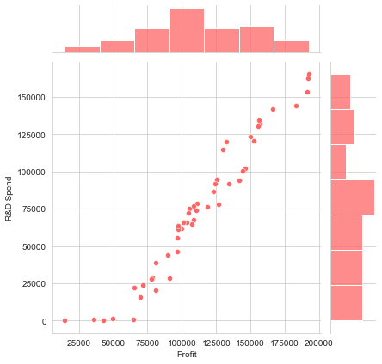
Joint plot:

Slide 5
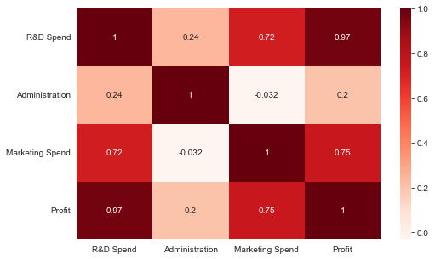
Heat map:
The above Heatmap tells us that there is a strong correlation between Profit and R&D spend, Profit and Marketing Spend. Hence we can consider that Spending in Marketing or in R&D can help in Increase of Profit.

Slide 6
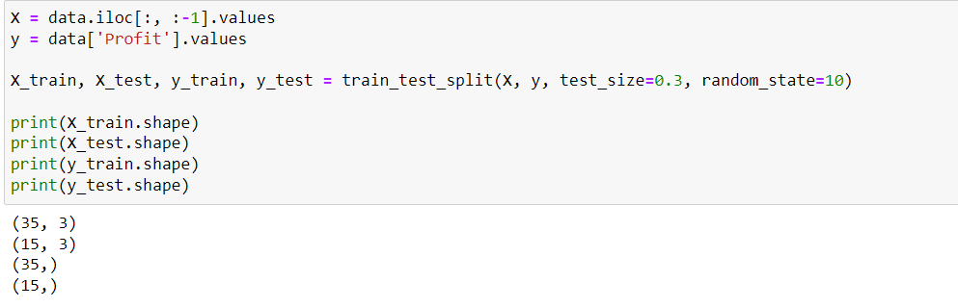
Train Test Split:

Slide 7
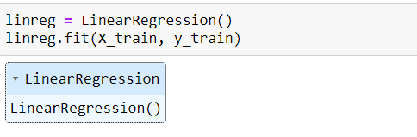
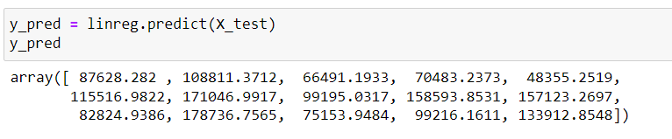
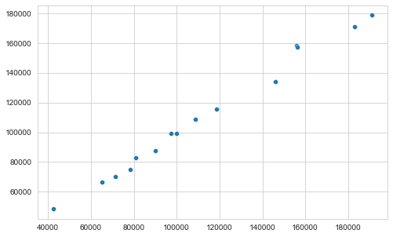

Linear Regression:

Slide 8
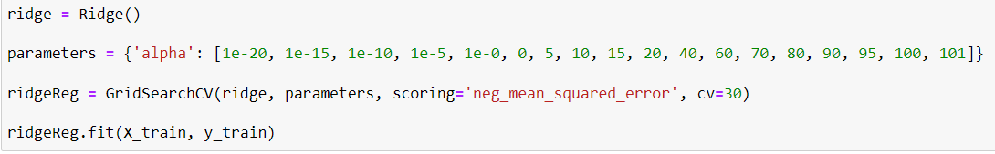
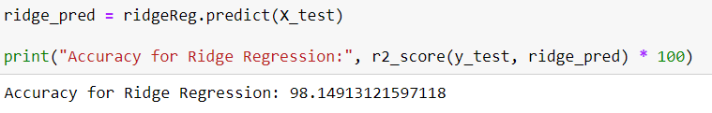
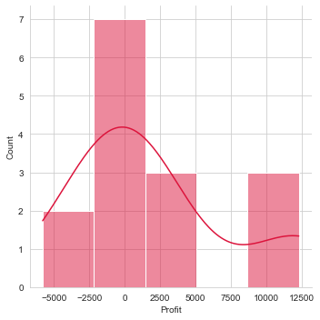
Ridge Regression:

Slide 9
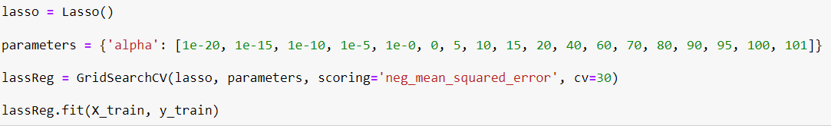
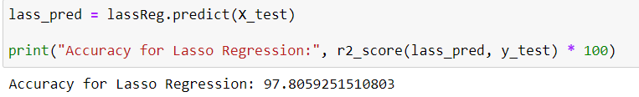

Lasso Regression:

Slide 10
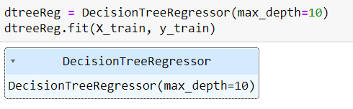
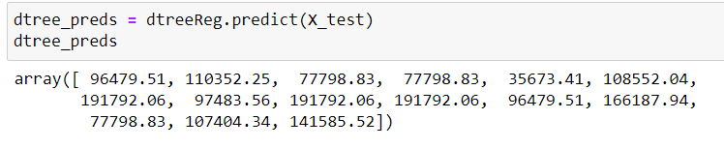
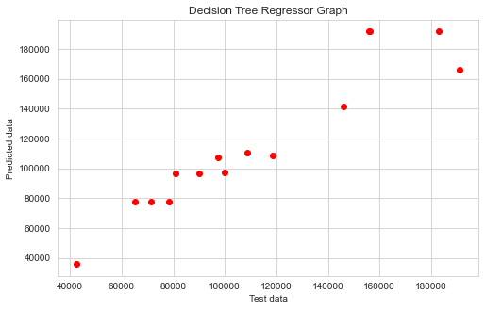
Decision Tree Regression:

Slide 11
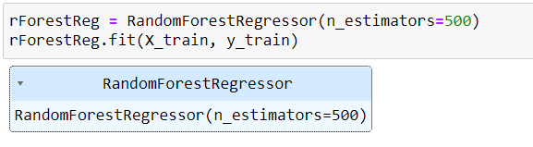
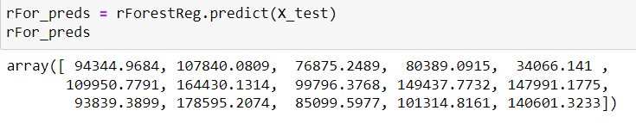
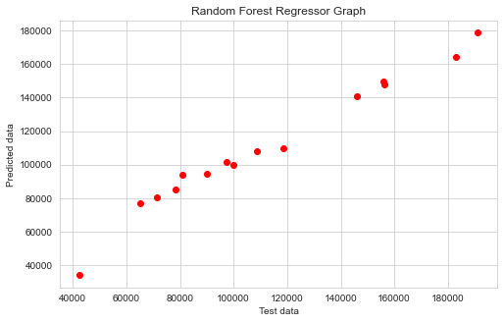
Random Forest Regression:

Slide 12
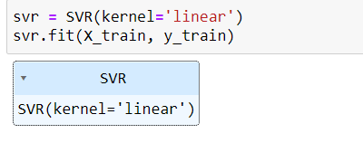
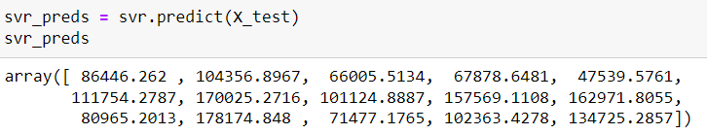
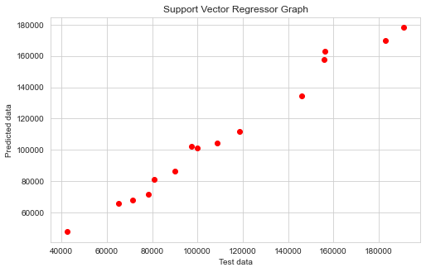
Support vector Regression:

Slide 13
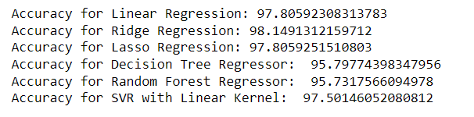
Conclusion:
The above accuracy test tells us about how well the models have performed with the 50 start-up data set. The data set only has 50 records as a result some models might have failed to deliver better results like Decision Tree Regression which performed very poorly, considering Random Forest Regression has performed much better than the Decision Tree model. Looking at the other models Linear, Ridge, Lasso, SVR have almost similar results with small variations in accuracy. Hence we can conclude that it depends on the model that we select on which data set the model is going to perform well.

Slide 14


==== Thank you ====

